Slide 1
Weekly Progress
Classification
k-fold stratified cross validations
Correlation columns grouping
Corr, ABS(Corr), Corr^2
Higher difference correlation within group
Trying with classification benchmark problem?
Grouping with columns sequence?

Slide 2
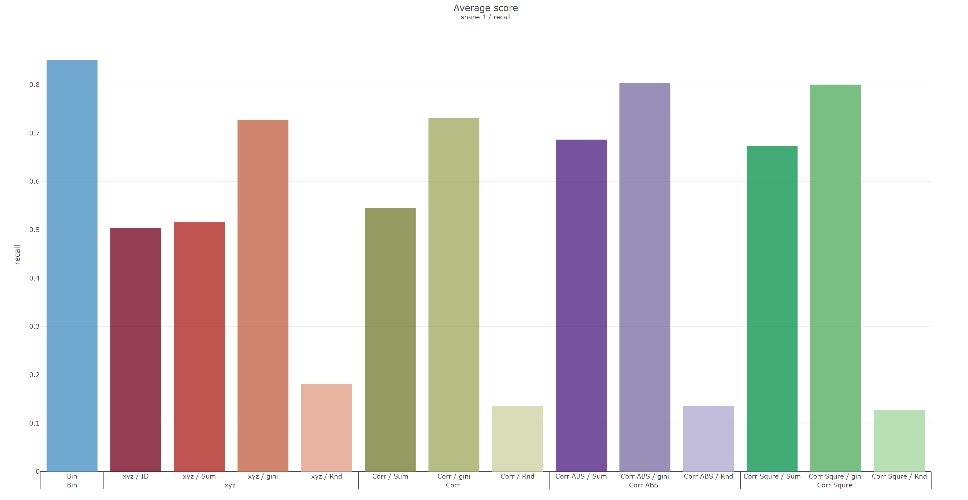
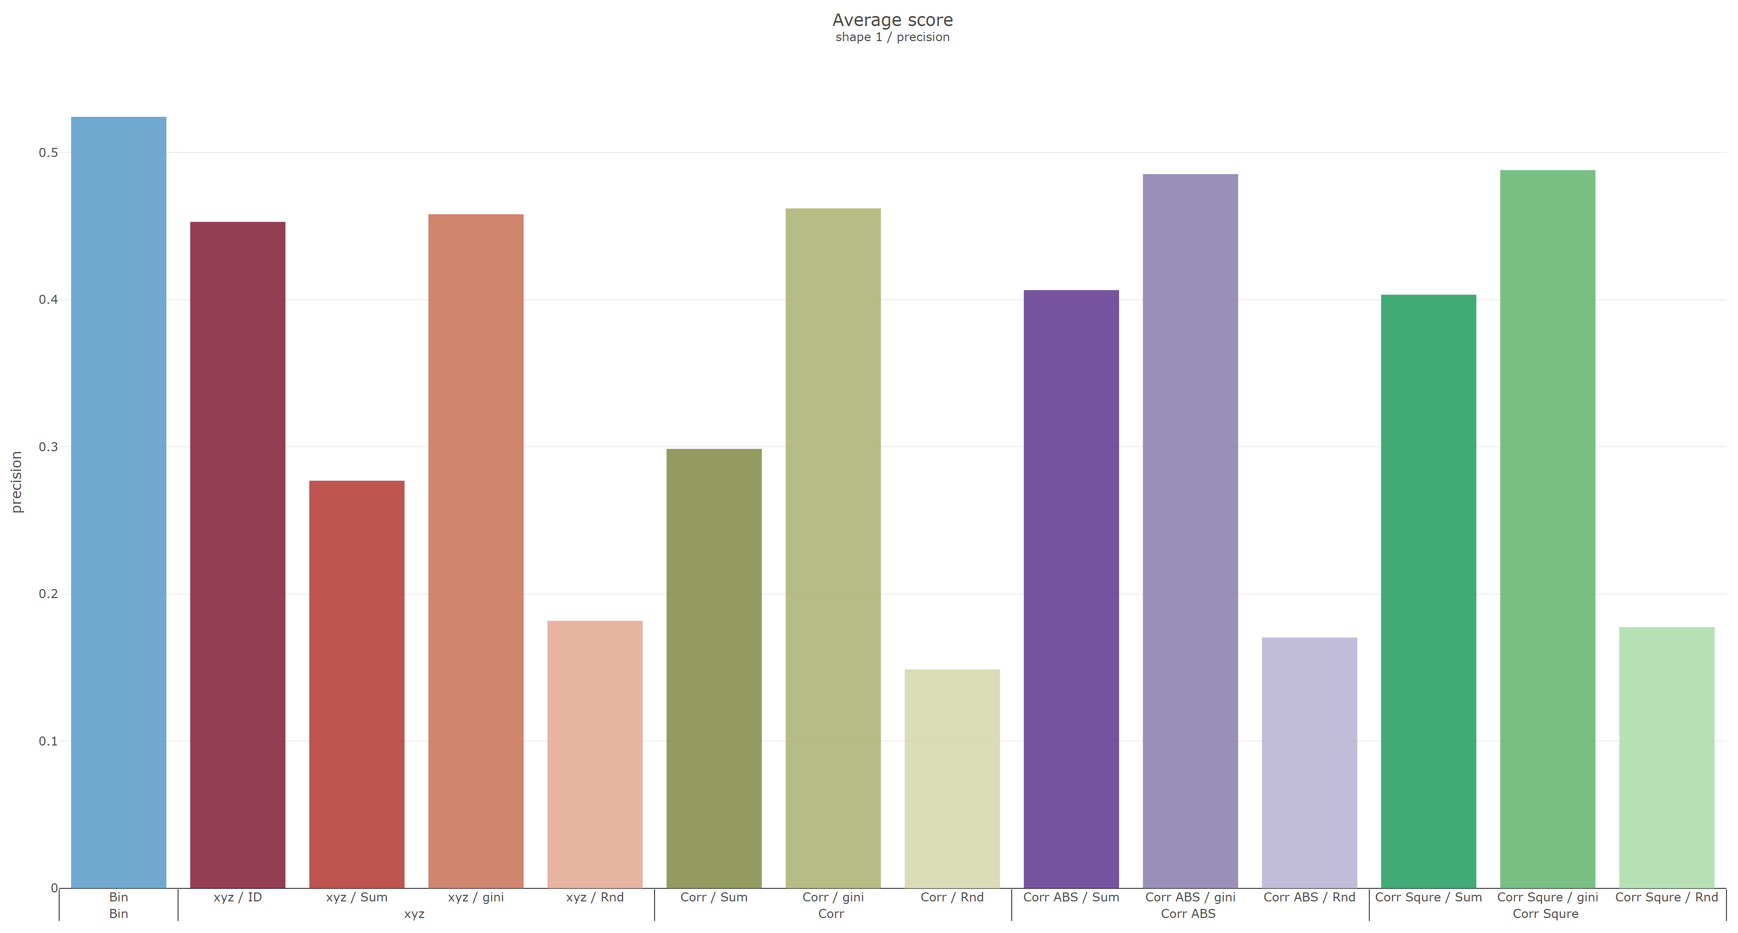
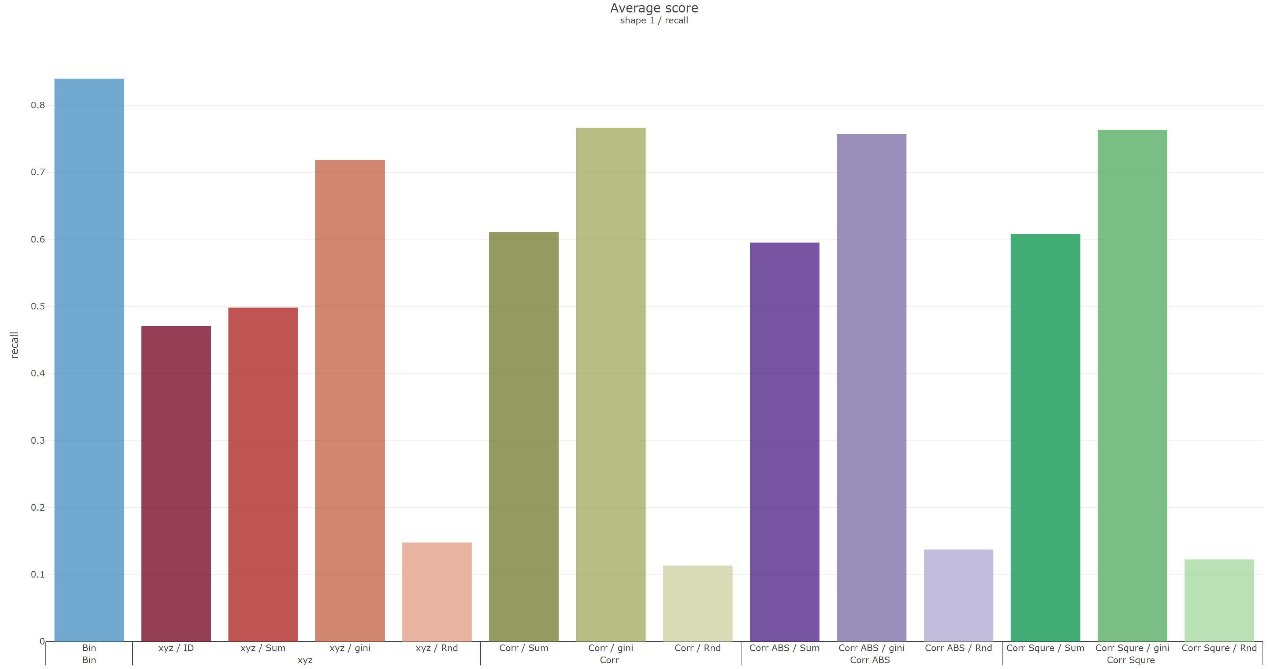
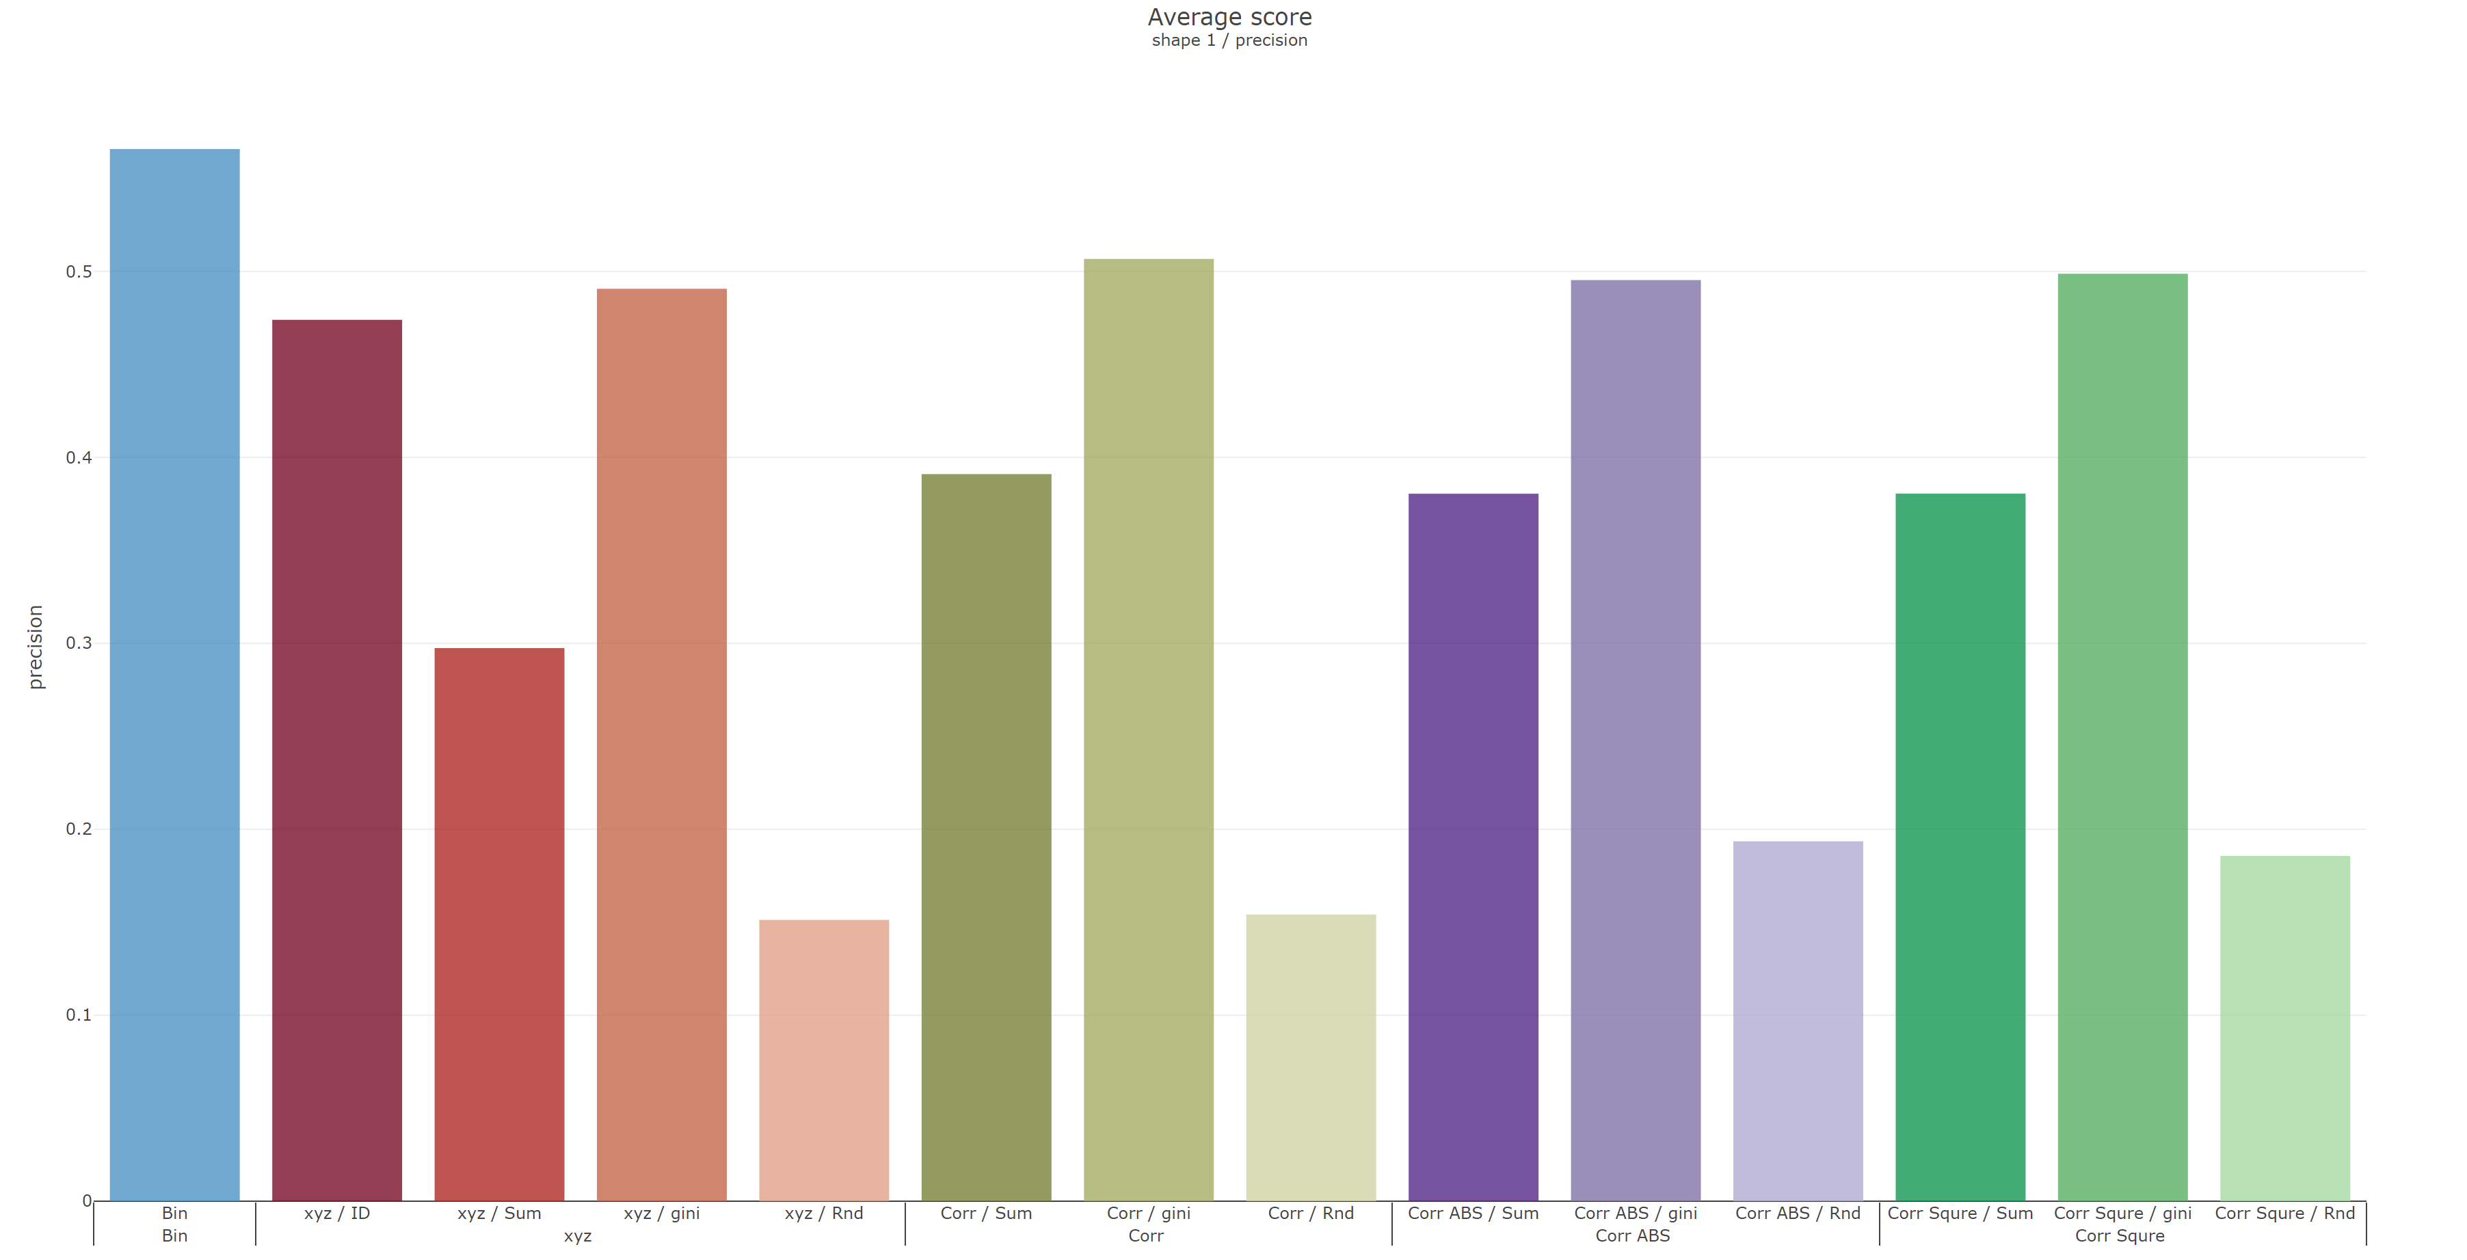
Shape 1
 | Recall | Precision
Reverse
Original

Slide 3
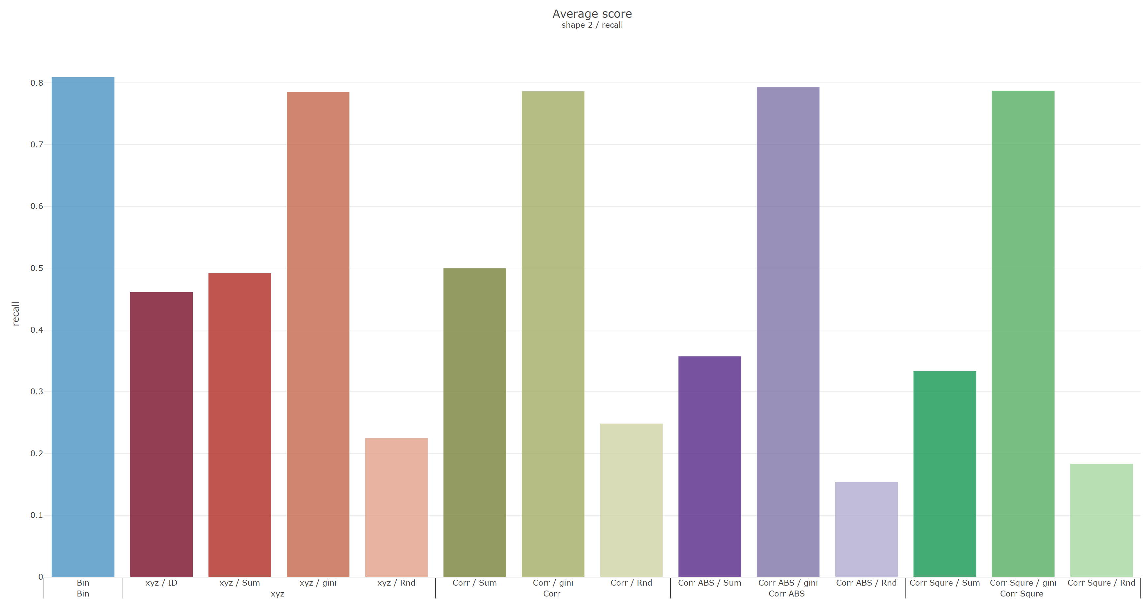
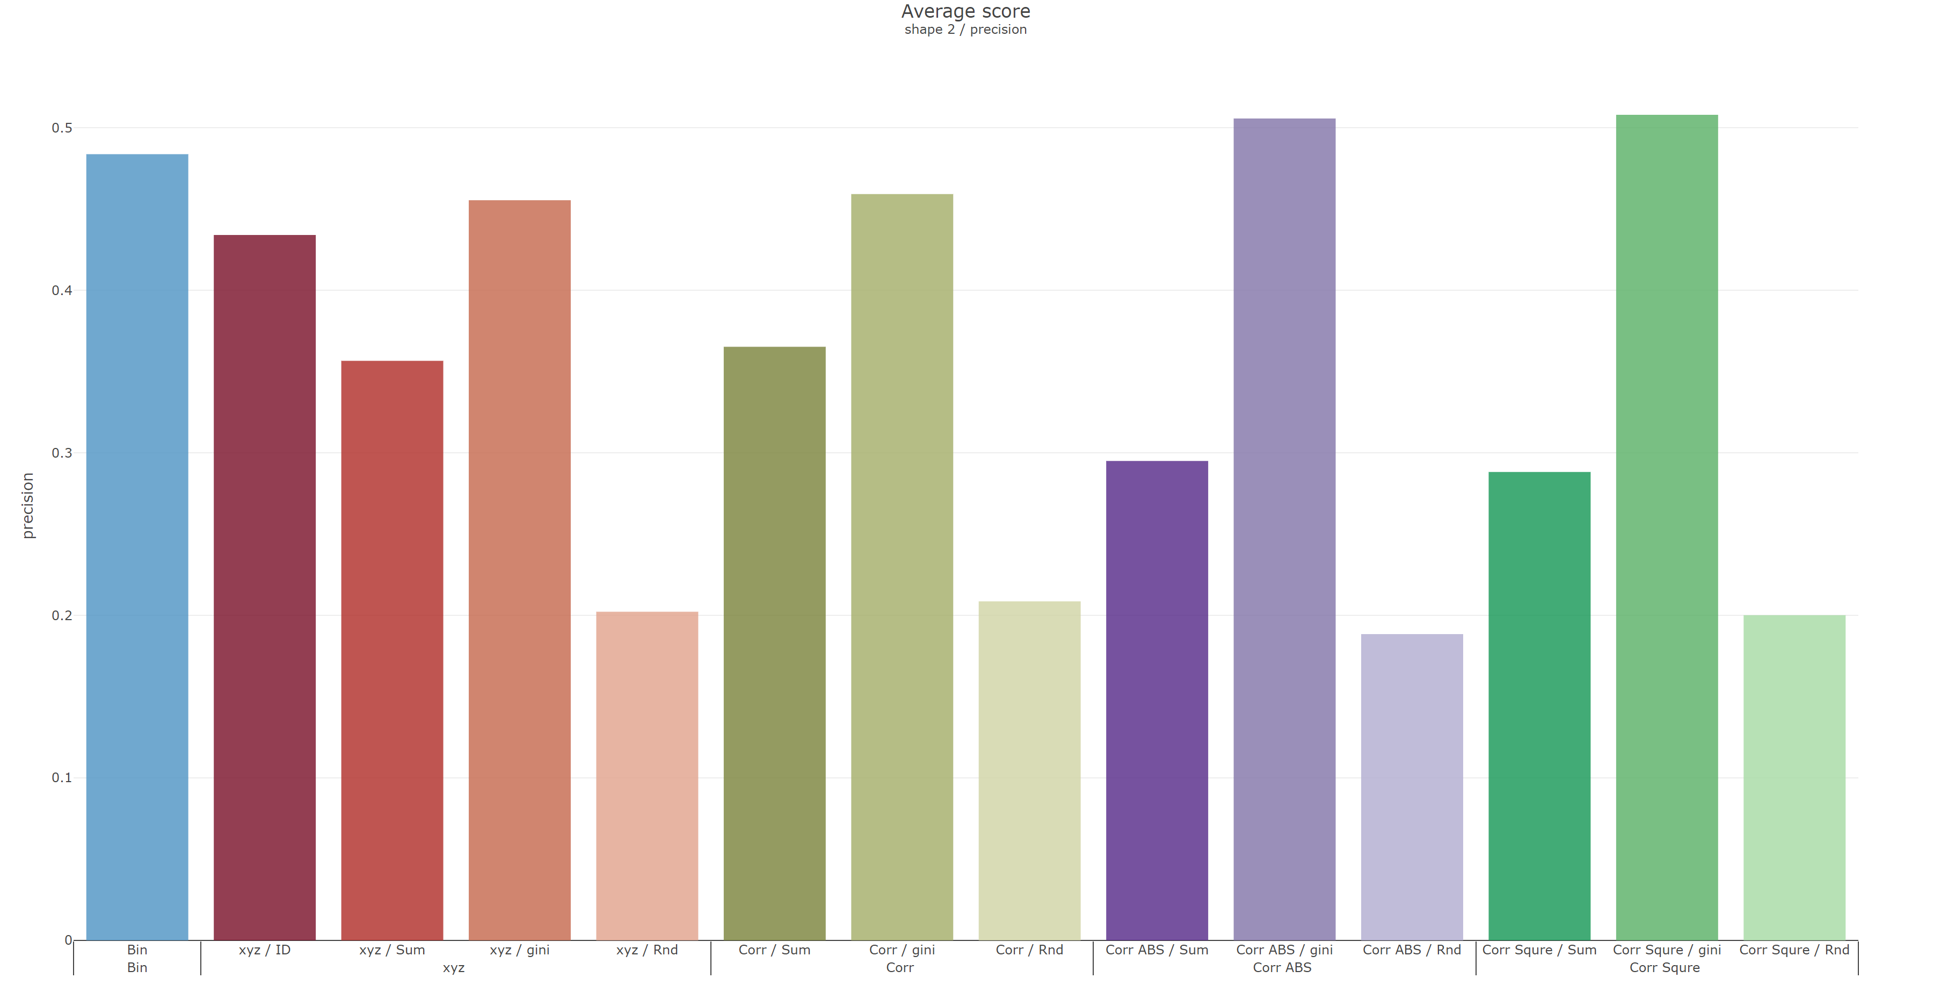
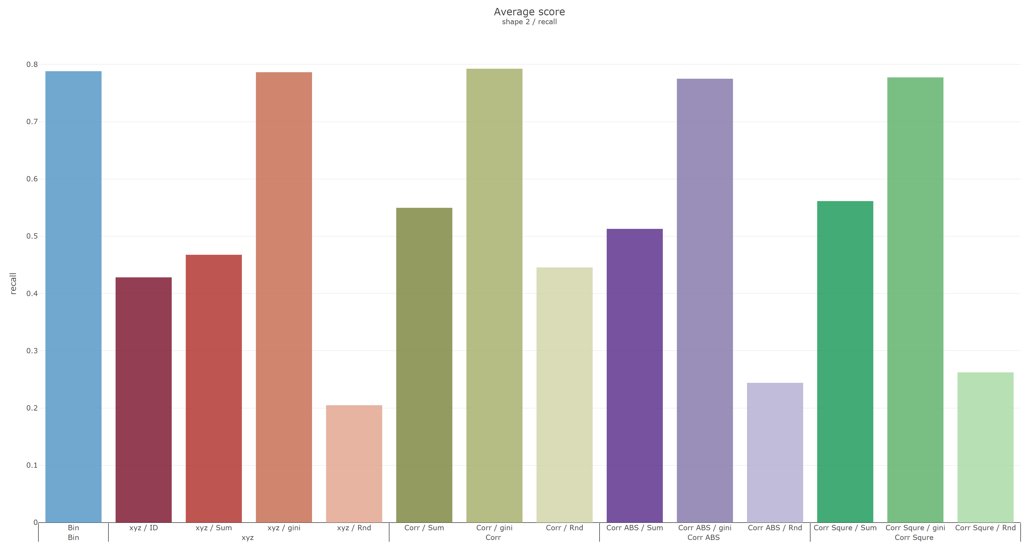
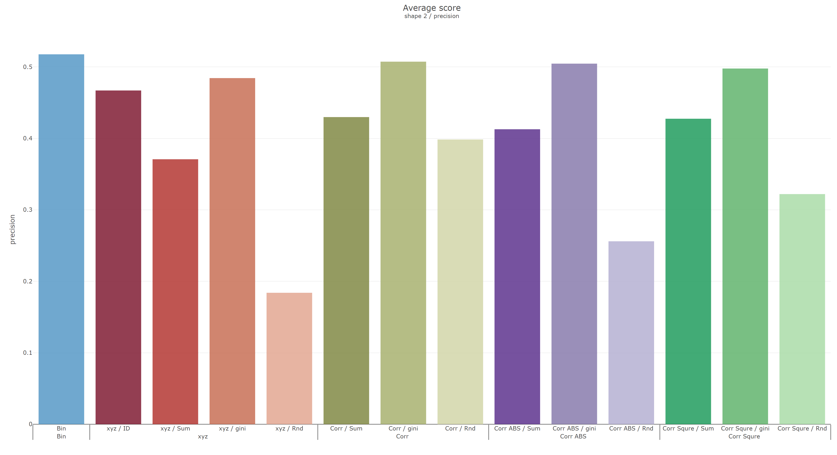
Shape 2
 | Recall | Precision
Reverse
Original

Slide 4
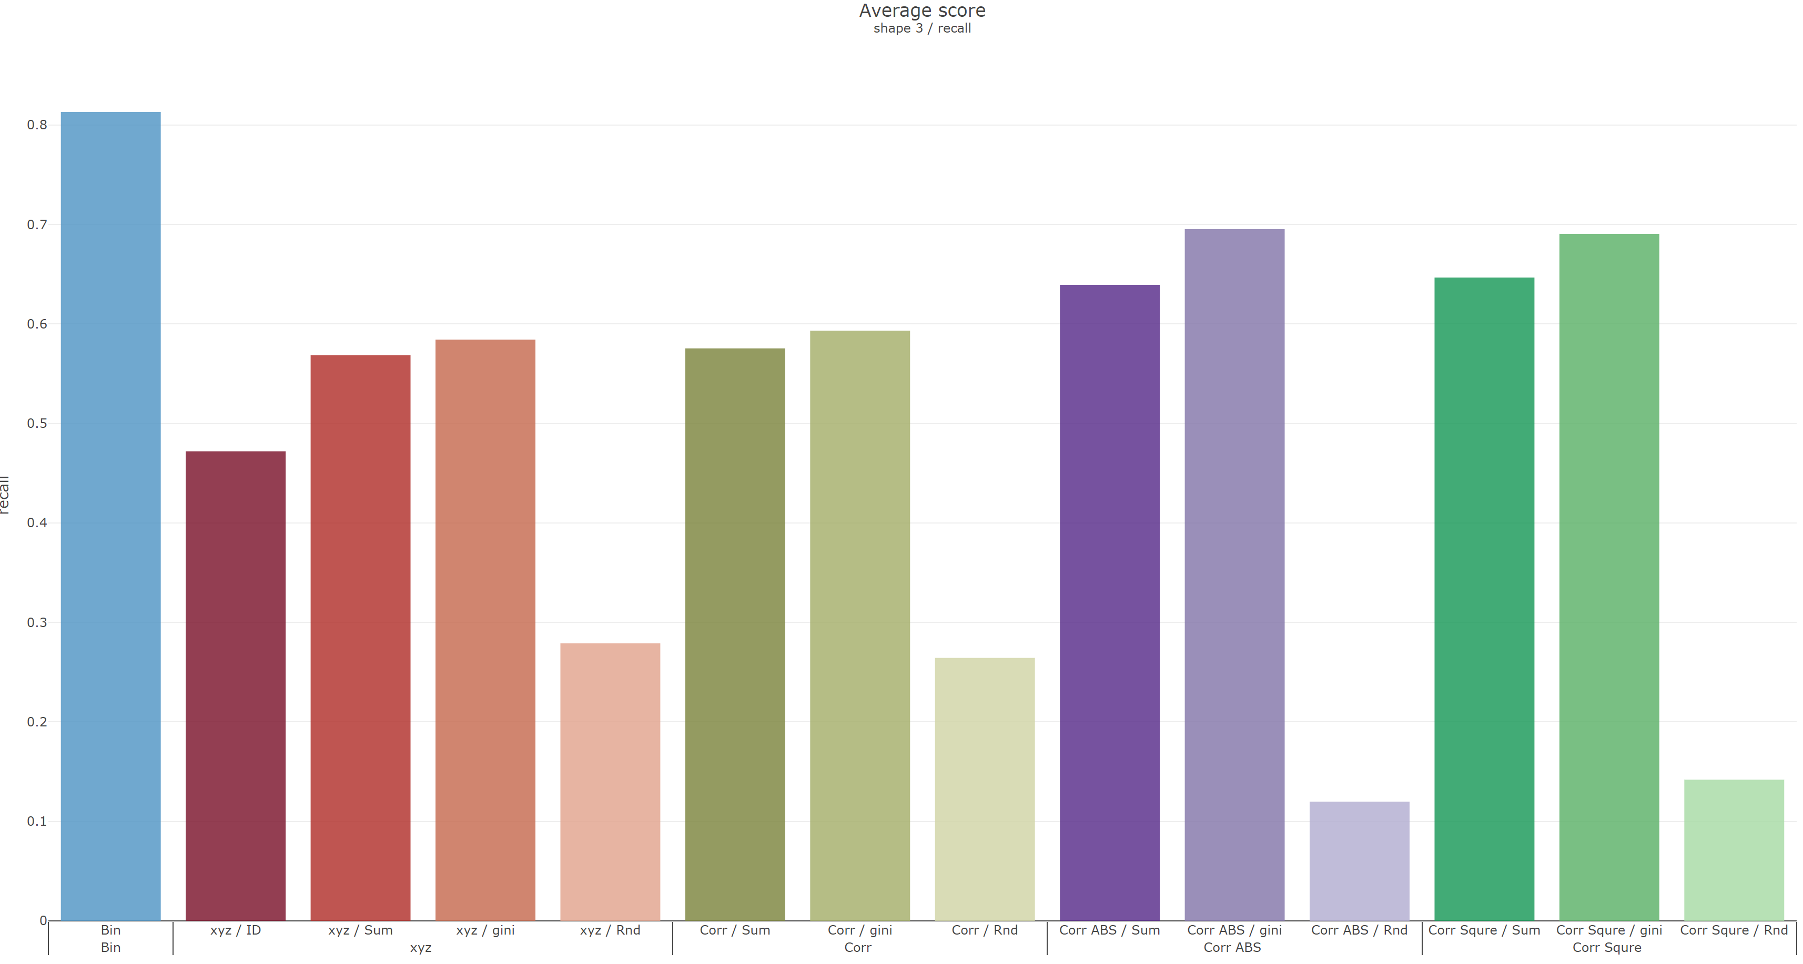
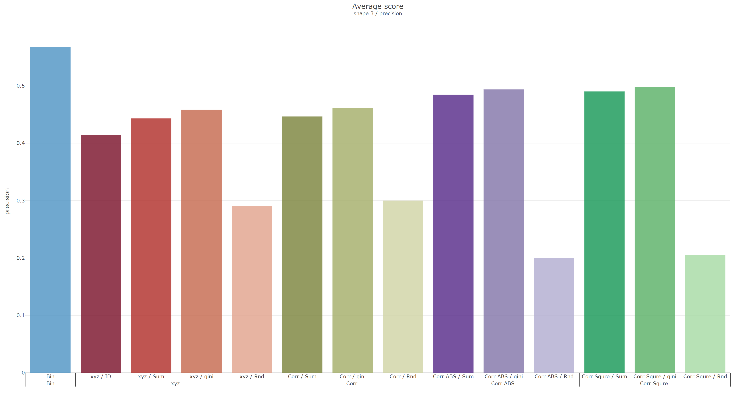
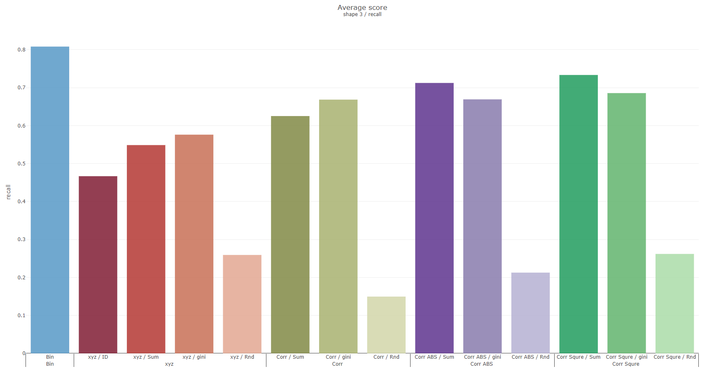
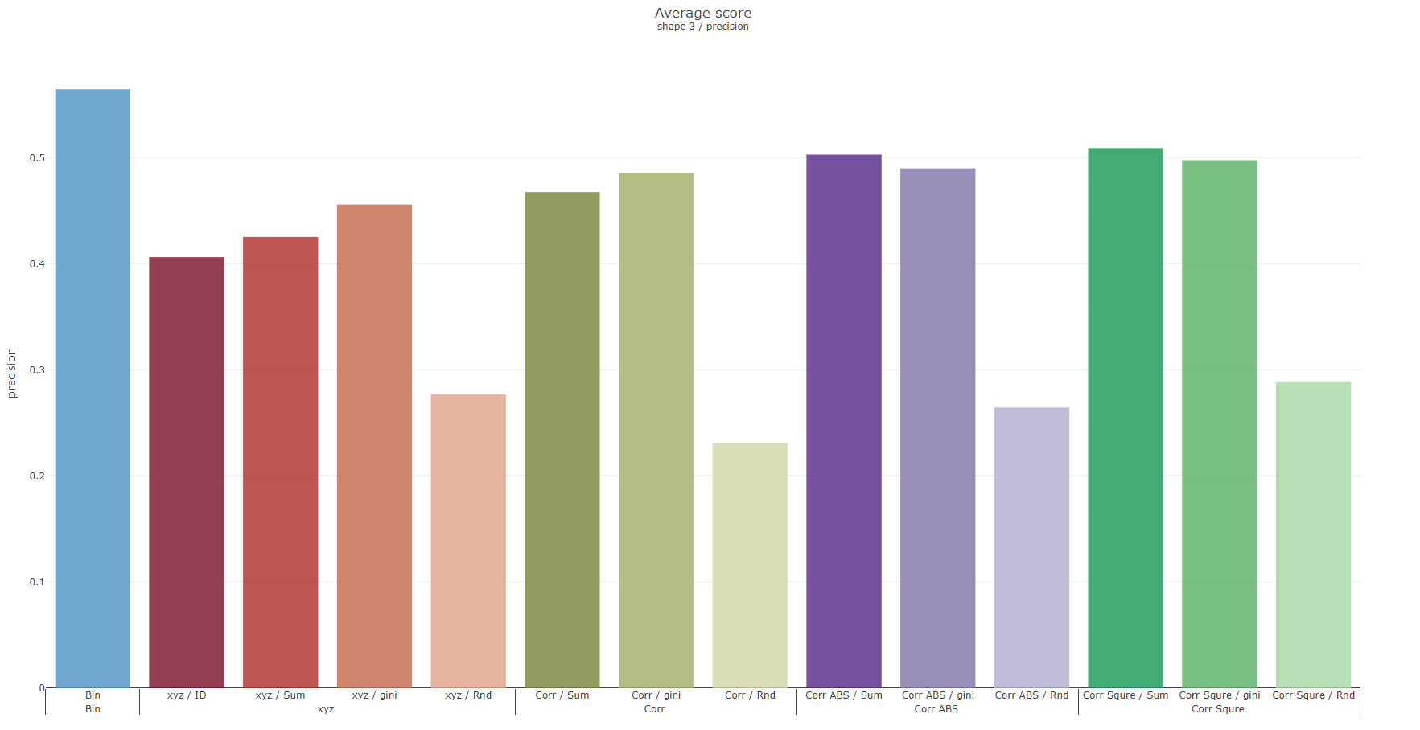
Shape 3
 | Recall | Precision
Reverse
Original

Slide 5
Grouping with columns sequence
S sorting
G-1 | G-2 | G-3 | G-4 | G-5 | G-6 | G-7
G-14 | G-13 | G-12 | G-11 | G-10 | G-9 | G-8
G-15 | G-16 | G-17 | G-18 | G-19 | G-20 | G-21
Notes:
K-fold deviation
Hybird dataset(cont., binary)
UCI
確認遠端還是實體口試

Slide 6
Record K-fold deviation
Grouping with columns sequence
Testing hybrid dataset(both cont. and bin.) on UCI
Make sure remote or physical oral test

Slide 7
Weekly Progress
Classification
Record K-fold deviation
Compared with ordinal, and mean encoding
Testing with UCI datasets on 4, and 10-folds
Car Evaluation Data Set
Adult Data Set
Grouping with columns sequence
Try with others UCI datasets

Slide 8
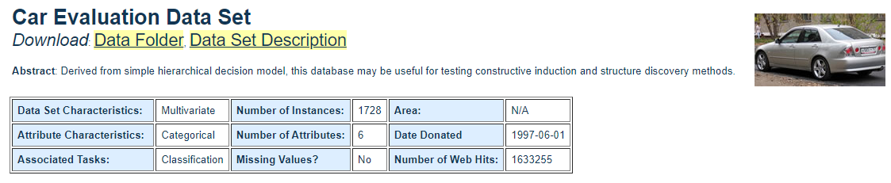
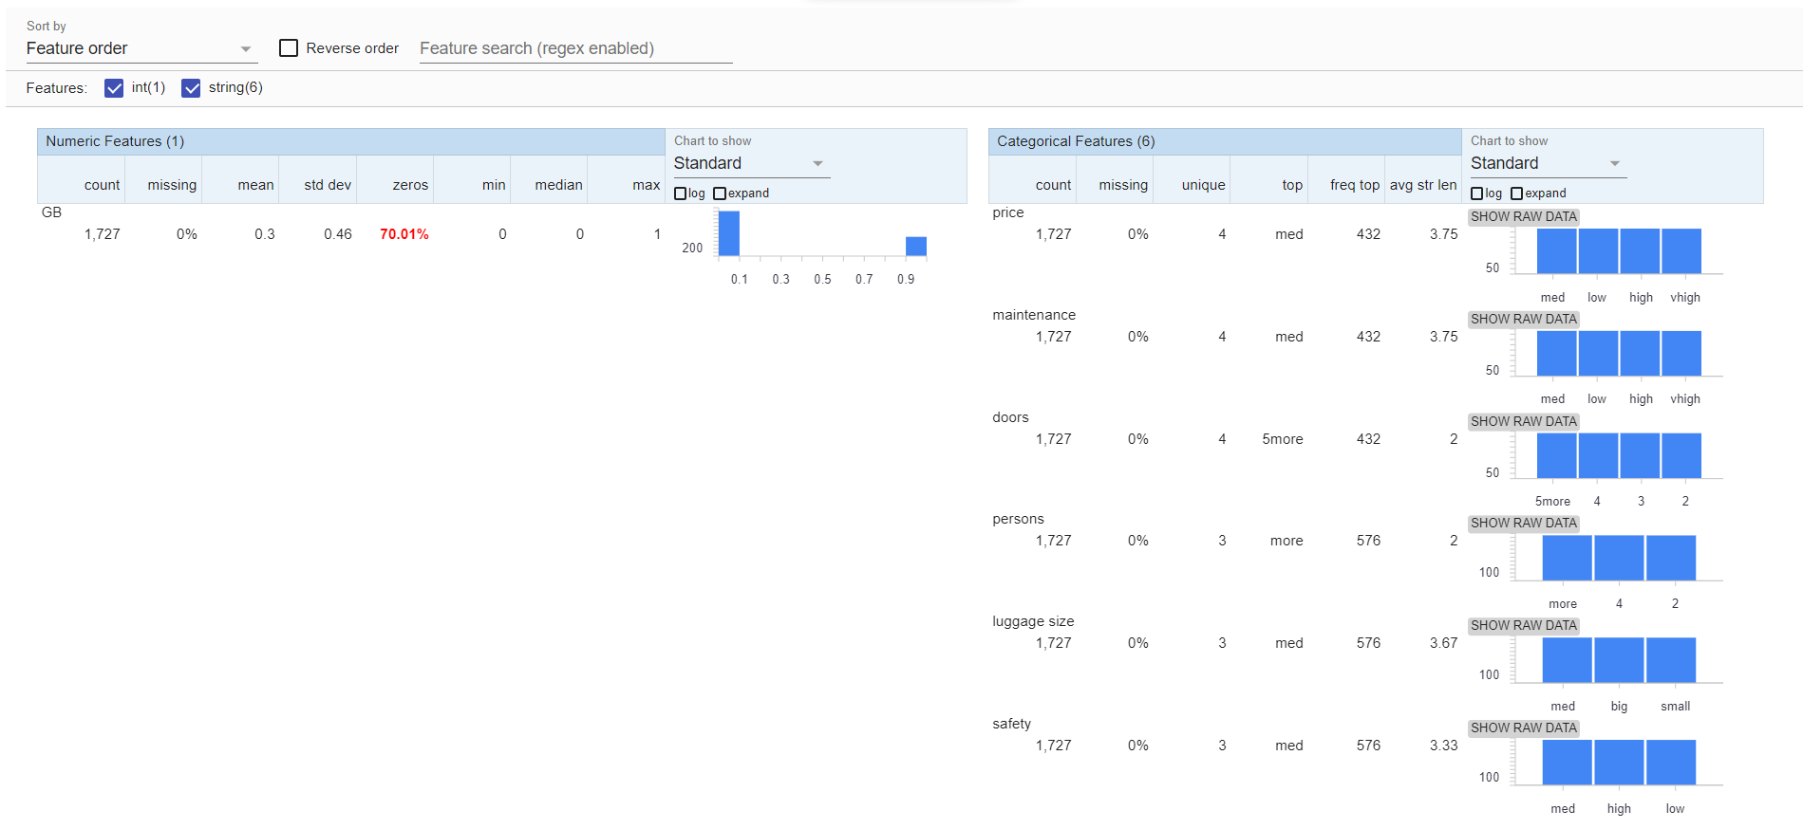
Car Evaluation Data Set

Slide 9
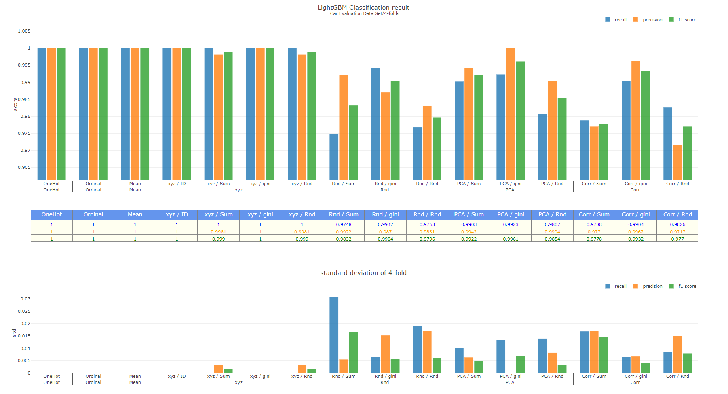

Slide 10
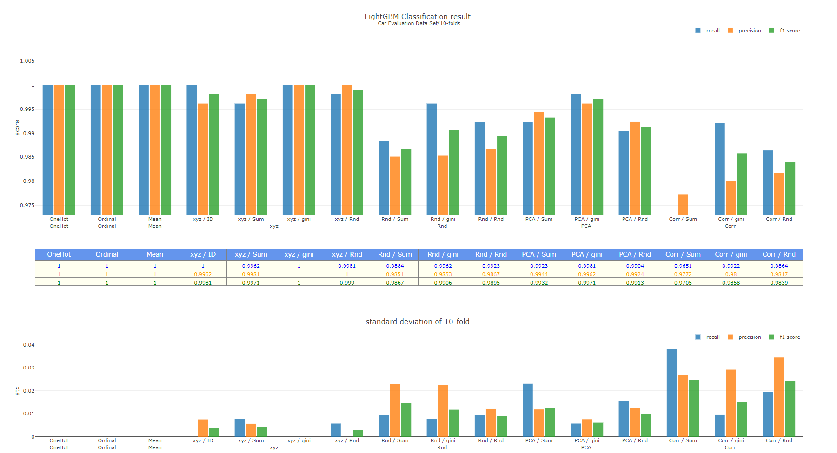

Slide 11
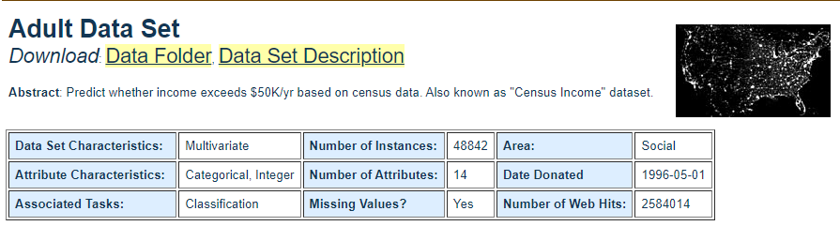
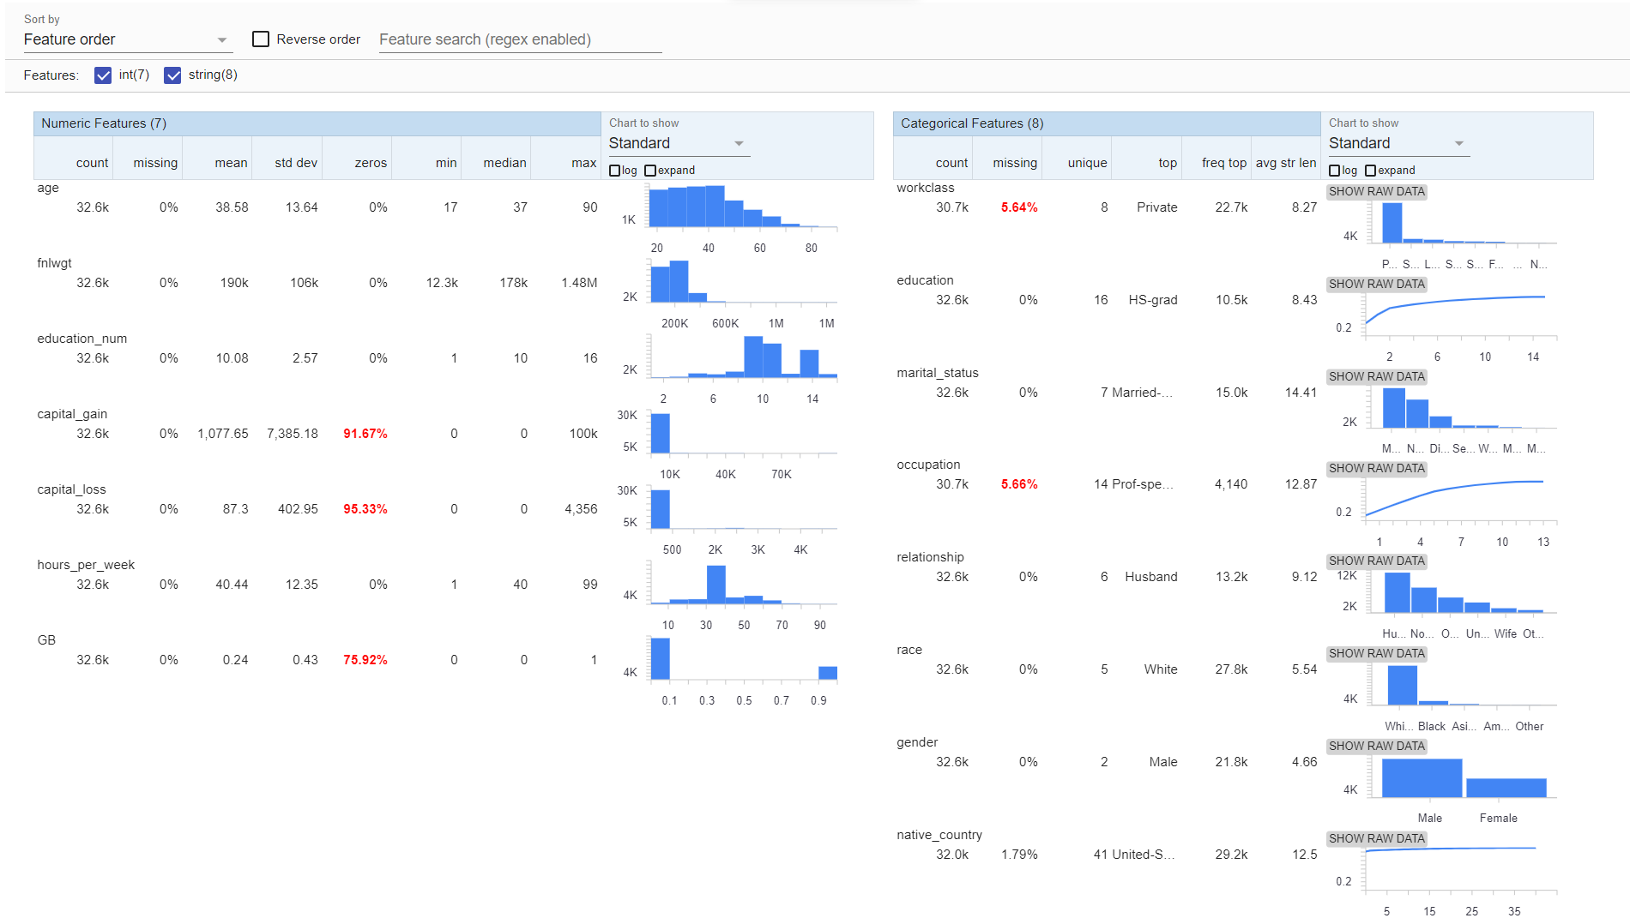
Adult Data Set

Slide 12
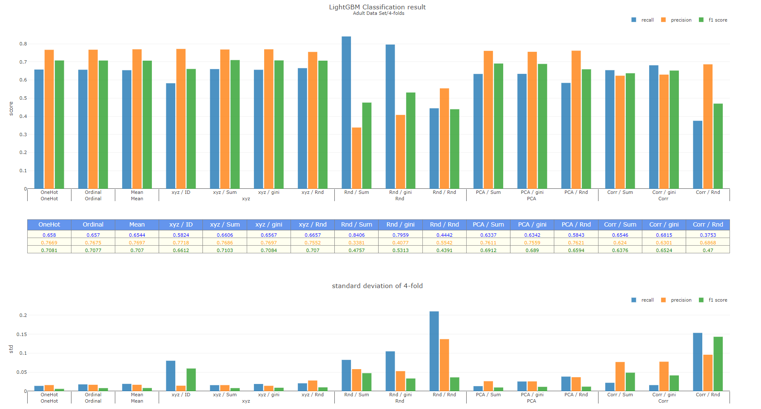

Slide 13
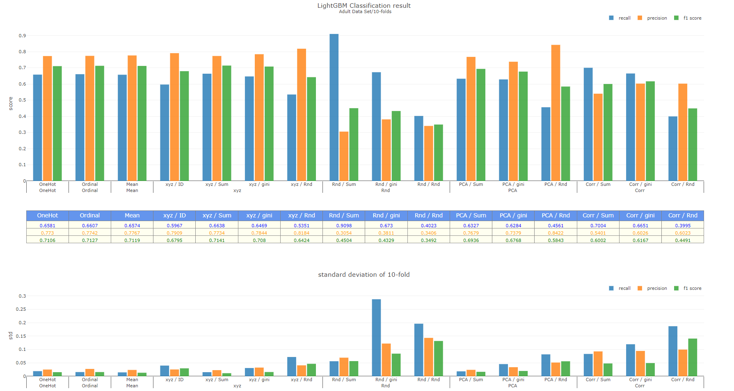
Notes:
Feature importance
AUO data
Imbalance
Kaggle, PWC
信用卡盜刷
目錄

Slide 14
To-do
Datasets
AUO data
Imbalance (Kaggle, UCI, paper with code)
信用卡盜刷
Classification
Record feature importance
Thesis
Chapter 3,4 目錄

Slide 15
緒論
文獻回顧
研究方法
案例分析
結論與建議

Slide 16
Weekly Progress
Testing with AUO datasets on 2, and 3-folds
Original
Backward one hot encoded
Grouping with columns sequence
Testing with other imbalance datasets

Slide 17
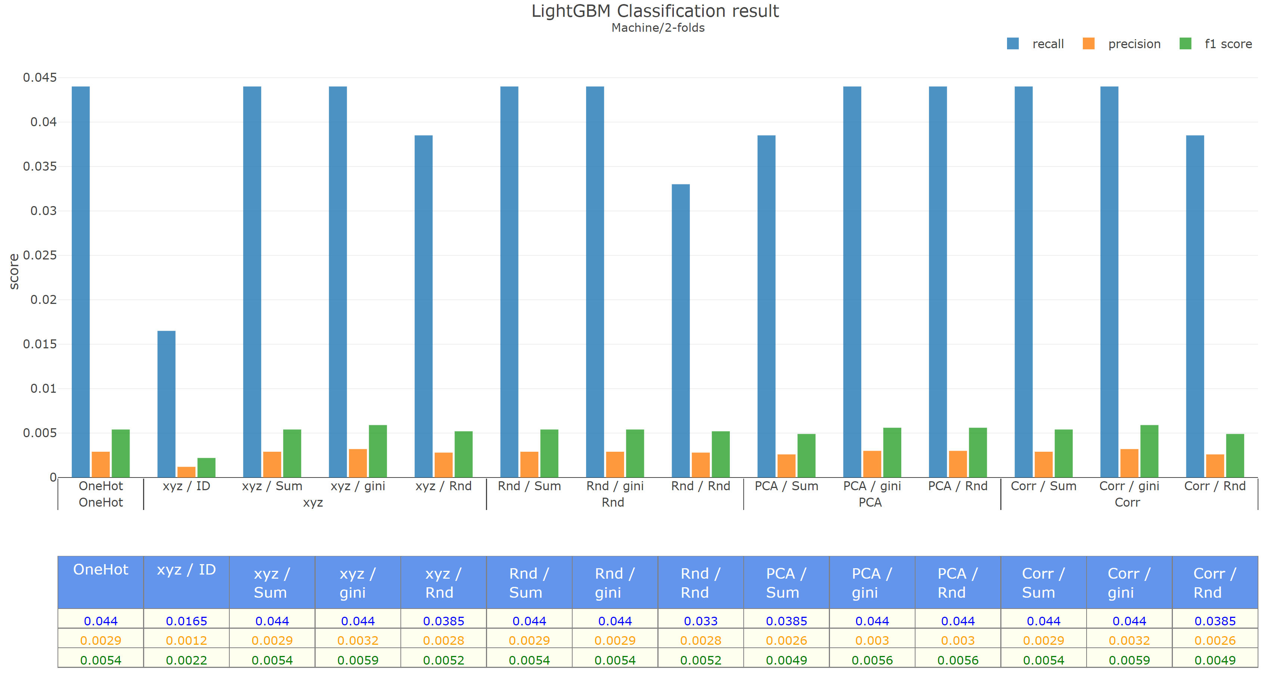
Original | Machine | 2-folds

Slide 18
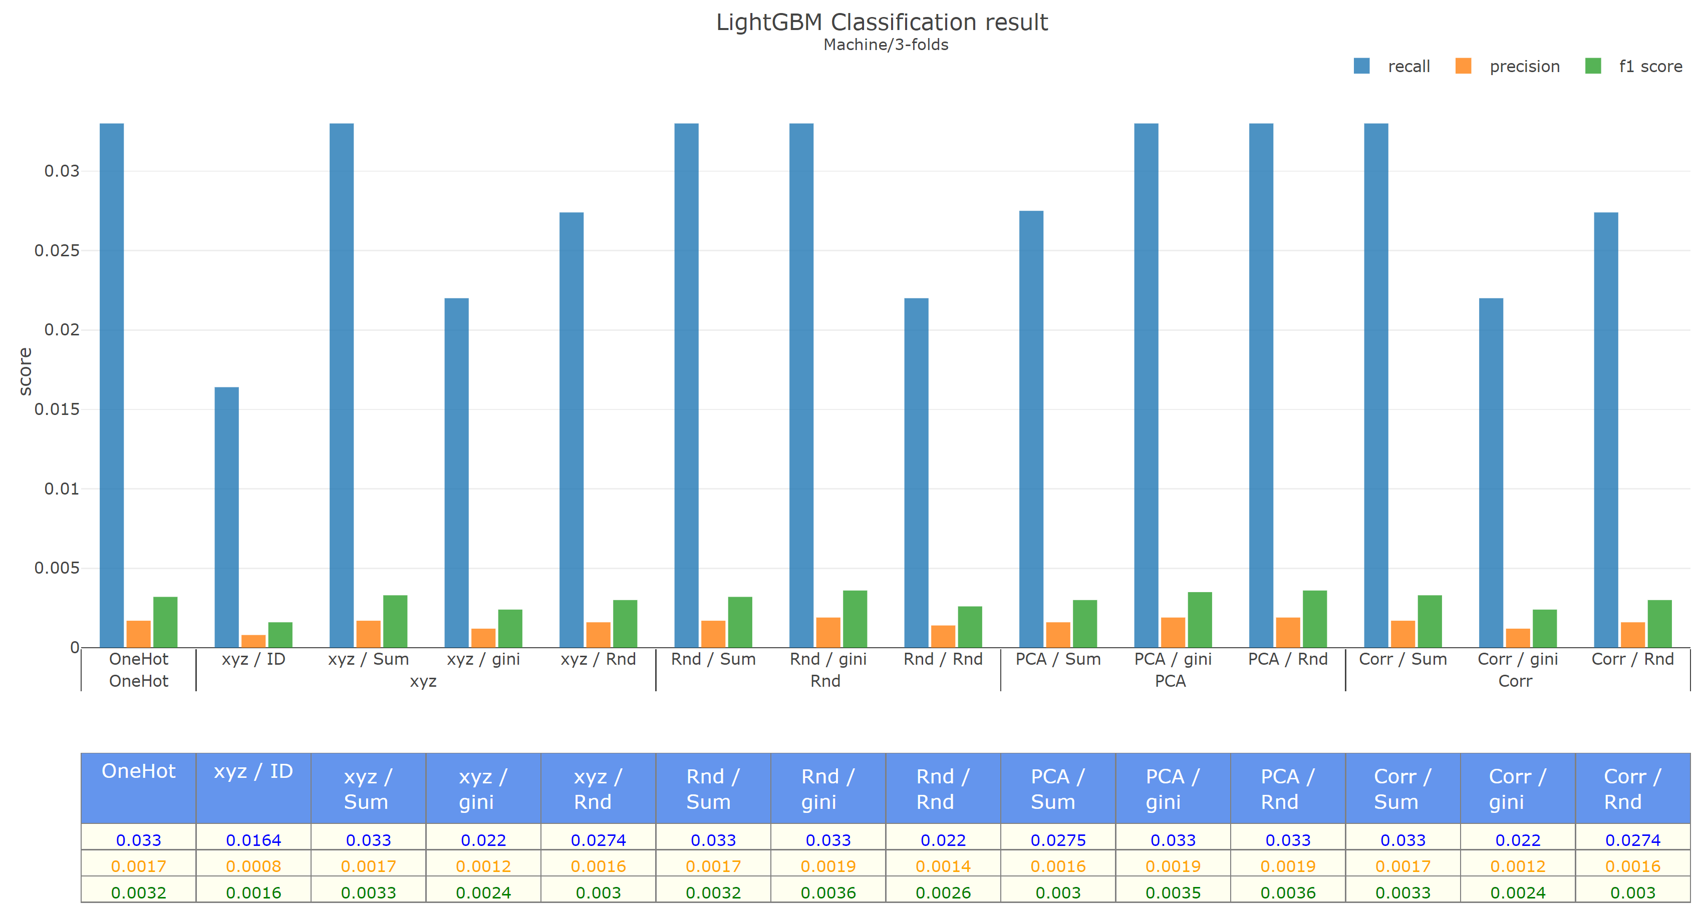
Original | Machine | 3-folds

Slide 19
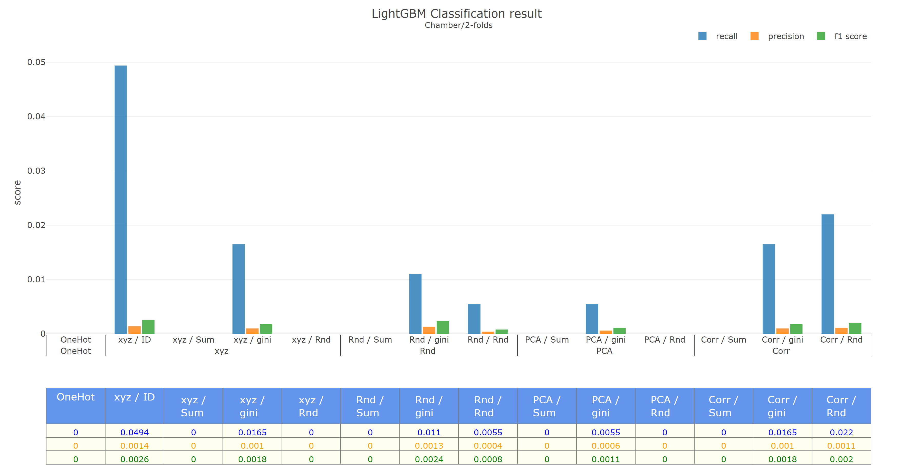
Original | Chamber | 2-folds

Slide 20
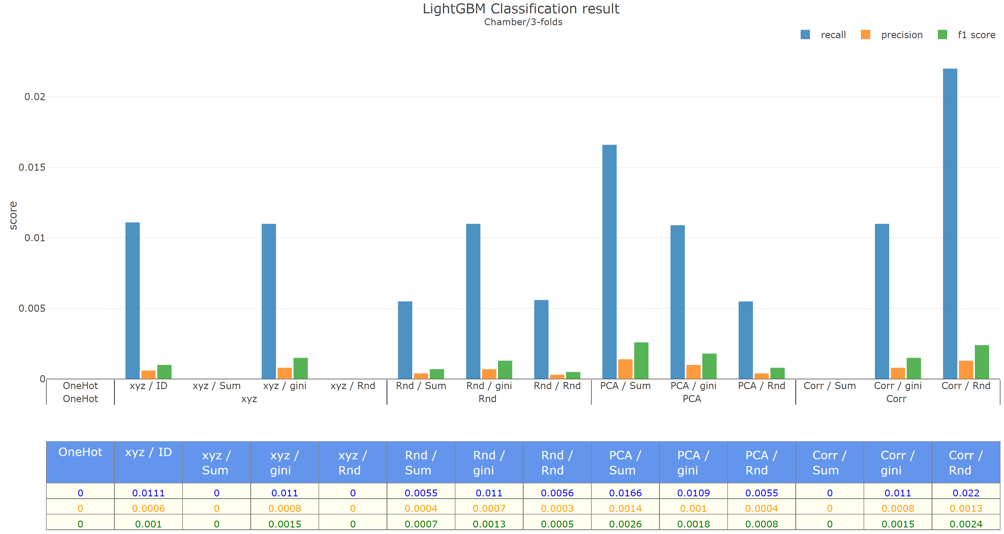
Original | Chamber | 3-folds

Slide 21
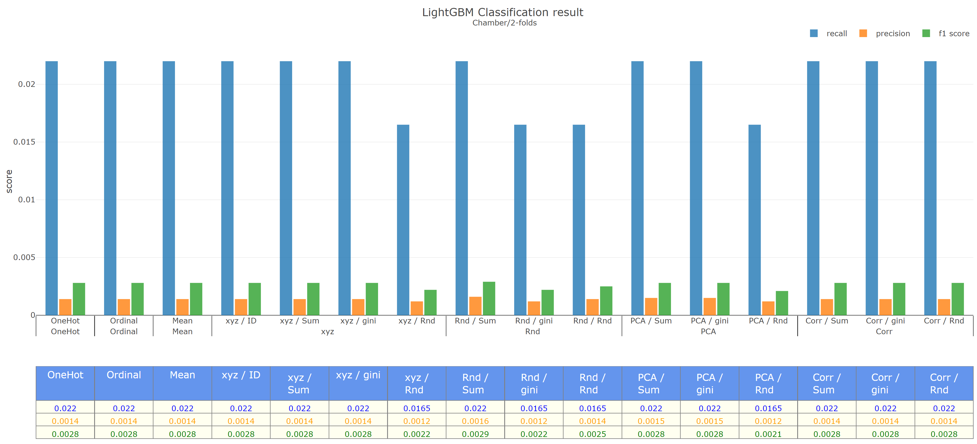
Backward | Machine | 2-folds

Slide 22
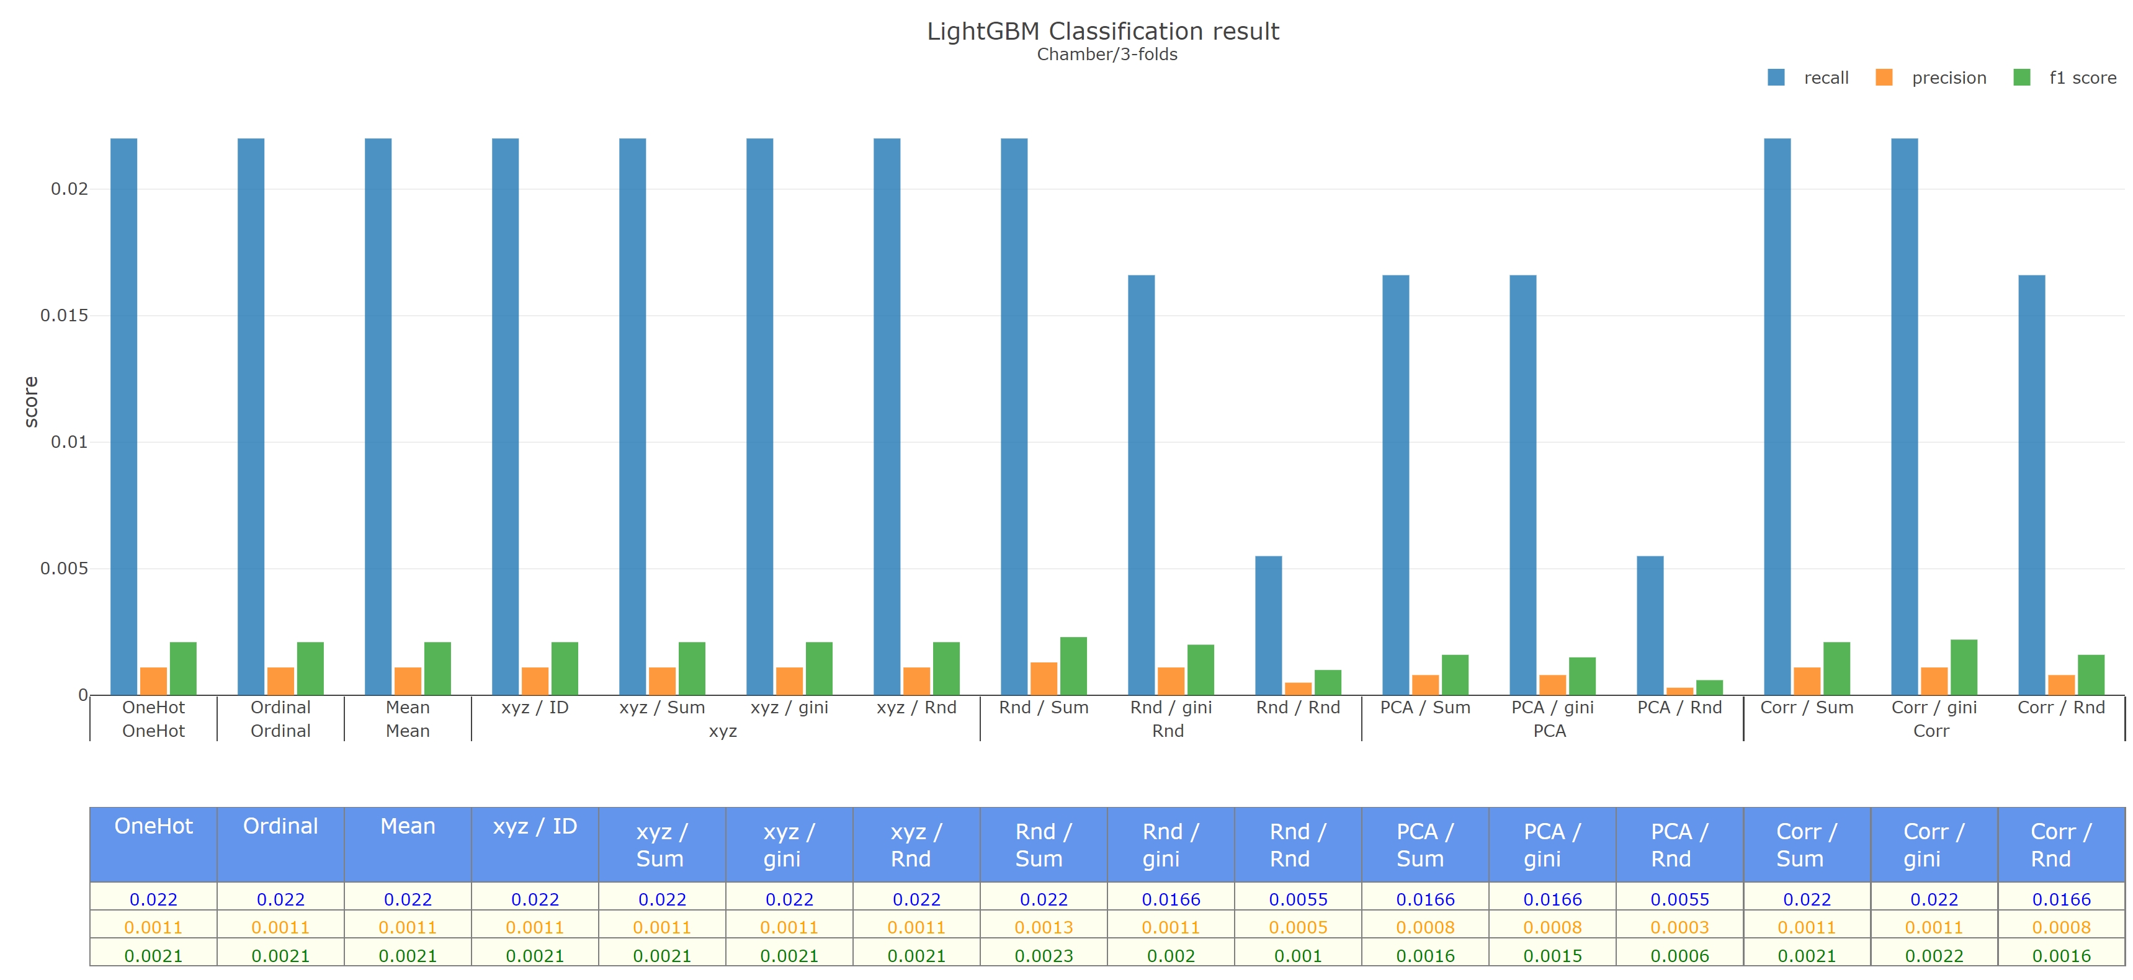
Backward | Machine | 3-folds

Slide 23
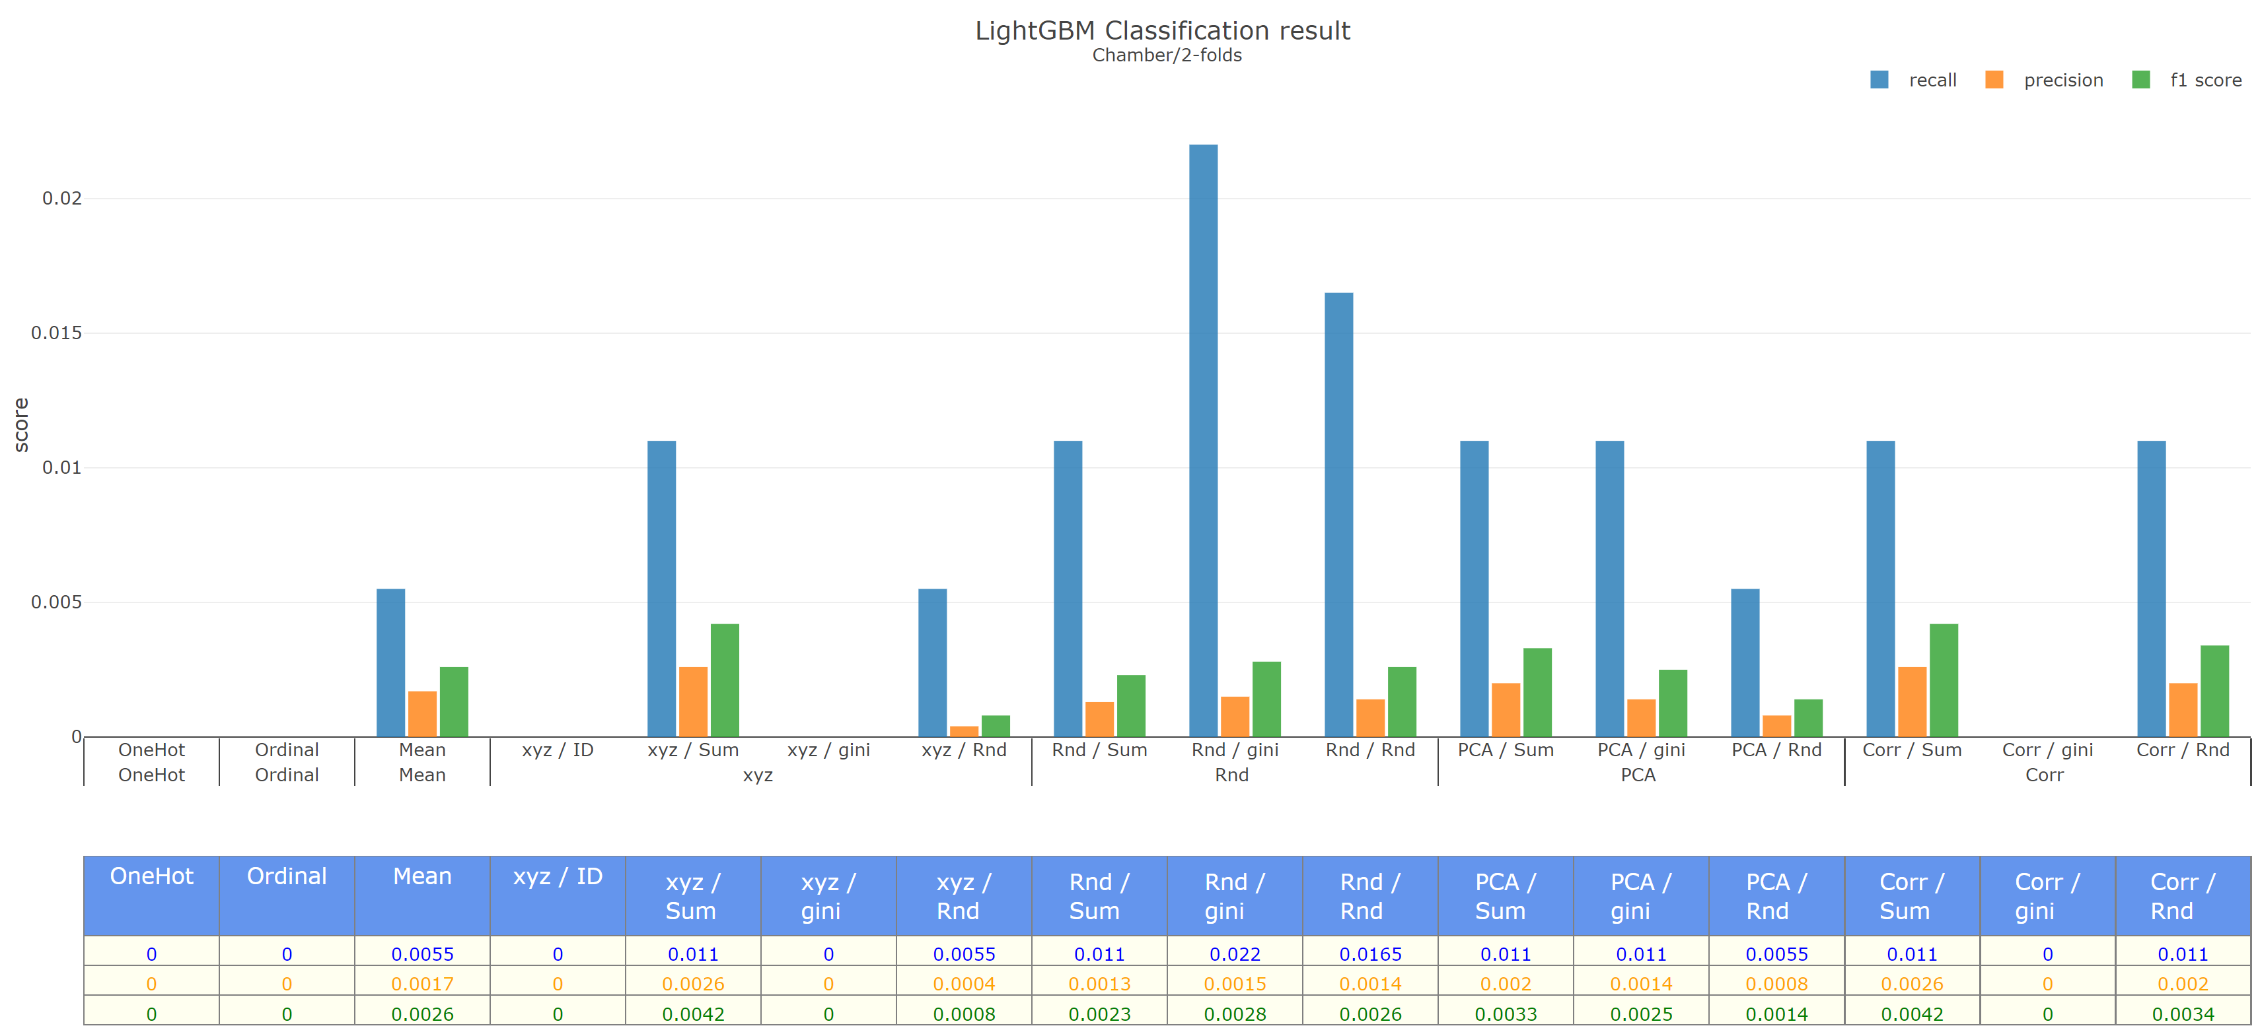
Backward | Chamber | 2-folds

Slide 24
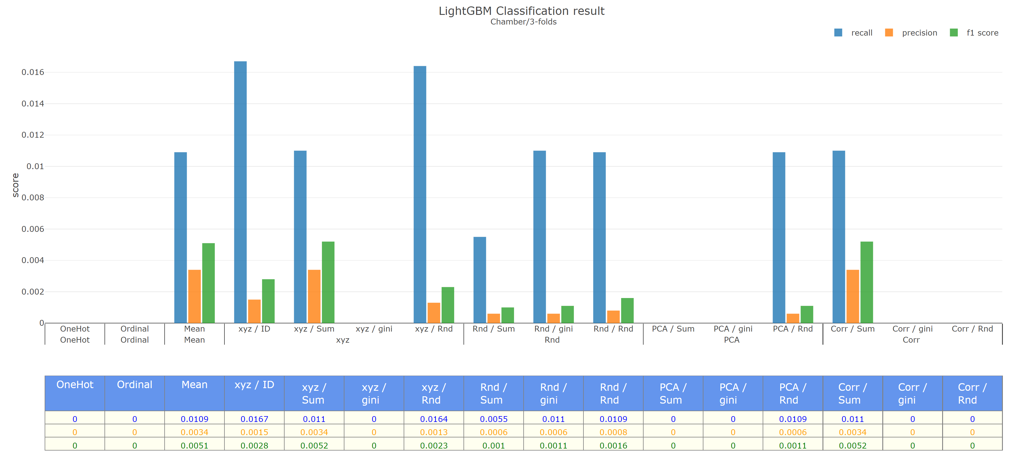
Backward | Chamber | 3-folds

